Slide 1
StudyPulse: Development of a Mobile-Based Student Performance Tracker with Built-in Reviewer and Quiz System for Third Year BSIT Students
BSIT-3A
IT-CAP01

Slide 2
INTRODUCTION
In today’s digital era, mobile technology plays a crucial role in education, reshaping how students access learning resources, monitor their progress, and assess their academic performance.

Slide 3
STATEMENT OF THE PROBLEM
No centralized system
Disorganized study process
Poor time management
Hard to identify strengths

Slide 4
SCOPE
Android only
Includes built-in quiz system
Allows instructors to upload materials and quizzes

Slide 5
DELIMITATIONS
No iOS
No grading system
No chat
Limited users

Slide 6
Review Related Literature
Mobile learning - improves accessibility and flexibility
Gamification - increases engagement and motivation
Quiz systems - enhance knowledge retention
Performance tracking - supports self-assessment and progress monitoring

Slide 7
GAP
Not integrated
Limited features

Slide 8
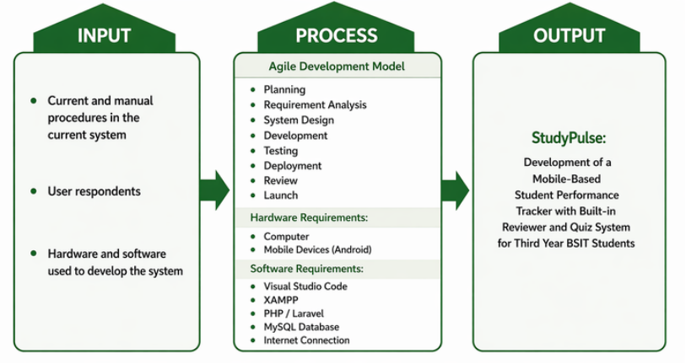
Conceptual Framework

Slide 9
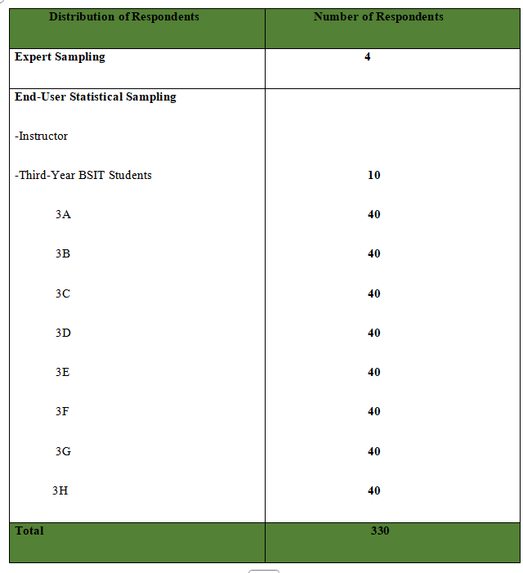
Respondents
of the
Study

Slide 10
THANK YOU!

